Slide 1
First year practicals
Lab 4: Risk and masculinity Social psychology in an experimental setting

Slide 2
Today’s study
So far in the course you have been learning about cognitive psychology experiments
Many social psychological constructs can also be studied in the lab
Today we’ll be looking at the effects of testosterone levels on risk taking behaviours
As a proxy measure for testosterone, we’ll measure your ‘digit ratio’
To measure risk-taking behaviour we’ll use the Balloon Analogue Risk Task (BART)
Then we’ll compare the risk taking for high- and low-testosterone individuals

Slide 3
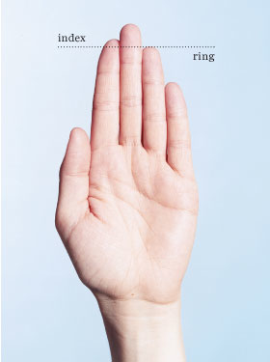
Digit ratio
‘Digit ratio’ is a possible way to measure testosterone, and male traits
On average males have longer ring (4th) fingers, relative to their index (2nd) finger, than females. This is thought to result from higher testosterone levels in-utero which are likely to continue to have effects later in life
The digit ratio is simply a way to quantify this difference in individuals

Slide 4
Measure your digit ratio
With a ruler measure the lengths of your index and ring fingers ON YOUR LEFT HAND, from the tip to the crease where your finger joins the hand
Calculate your digit ratio (in excel?) by dividing the index finger length by the ring finger length
This tends to be around 0.85. Lower values indicate more testosterone which is correlated with more masculine character. Higher values may indicate a more feminine character.
length of index finger
Digit ratio =
length of ring (4th) finger
Take a note of your digit ratio. Are classed as ‘high’ or ‘low’ testosterone on this measure?

Slide 5
Measuring risk taking tendency
There are many ways to measure risk taking behaviour with different pros/cons:
ask people whether they see themselves as risk-seeking/risk-averse (maybe they’ll lie?)
ask their friends/family whether they are a risk-seeker (do the friends know them well enough?)
ask them how they would react in various scenarios (less likely to lie but still might?)
measure how they actually react in those scenarios (often impractical?)
measure their risk-taking behaviour in a particular lab-based task (does it generalise?)
Notes:
For more on comparing various measures see
Aklina, Lejueza, Zvolenskyb, Kahlerc and Gwadzd (2005). Evaluation of behavioral measures of risk taking propensity with inner city adolescents

Slide 6
BART (Lejuez et al 2002)
The Balloon Analogue Risk Task (BART) measures risk taking in how far an individual wants to pump up a balloon for points (or actual financial) rewards
While being a lab-based behavioural task, the creators have shown that it correlates well with other measures of risk taking (Lejuez et al, 2002)
One of the interesting things is that men tend to be more risk-taking and women tend to be more risk-averse. Maybe people with higher testosterone (of either sex) will be more risk-taking
Today we’re going to run a slightly simplified version of the BART to see how testosterone relates to risk-taking
Notes:
C.W. Lejuez, J.P. Read, C.W. Kahler, J.B. Richards, S.E. Ramsey, G.L. Stuart, D.R. Strong and R.A. Brown, Evaluation of a behavioral measure of risk-taking: The Balloon Analogue Risk Task (BART), Journal of Experimental Psychology: Applied 8 (2002), pp. 75–84

Slide 7
Now download, open and run the BART experiment in PsychoPy
You do need to fill in the dialog box fully – all the information there is needed for the batch analysis!

